Slide 1
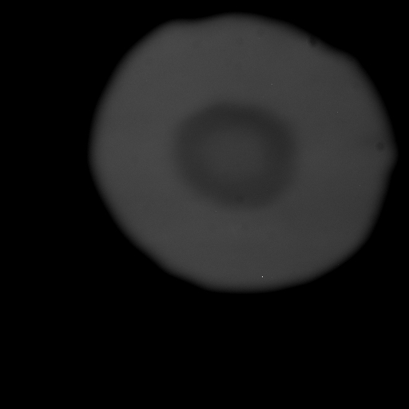
FO72a 2 April 2010 heating at ALS 12.2.2
Notes:
1 and heating spot

Slide 2
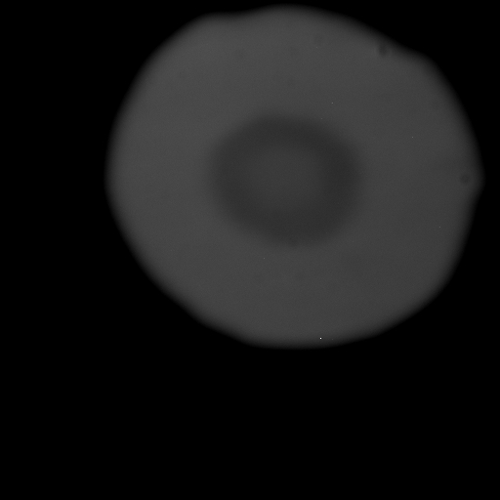

Slide 3
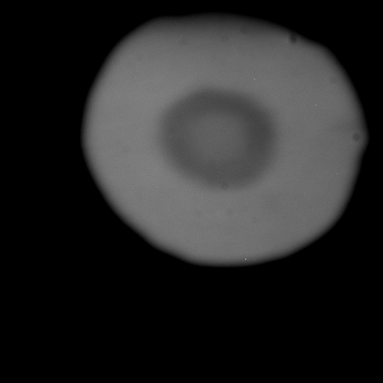
Notes:
2

Slide 4
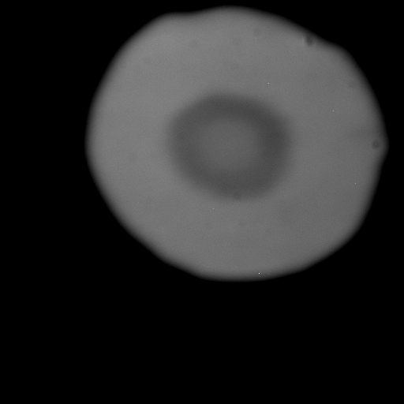
Notes:
3

Slide 5

Notes:
4

Slide 6
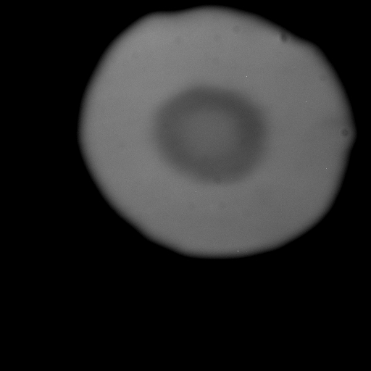
Notes:
5

Slide 7
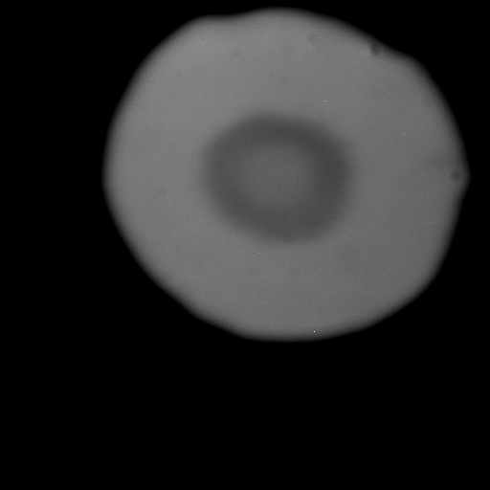
Notes:
6

Slide 8
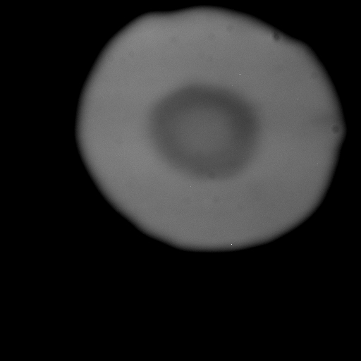
Notes:
7

Slide 9
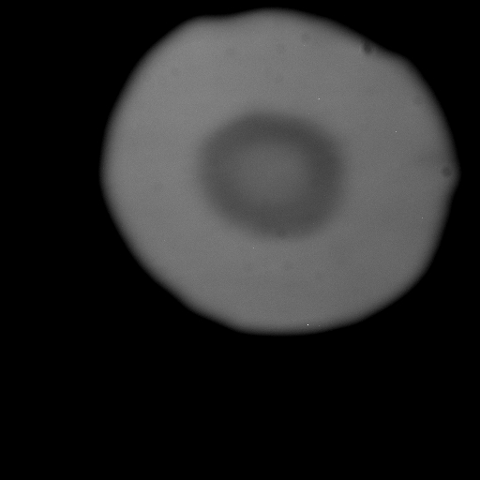
Notes:
8

Slide 10
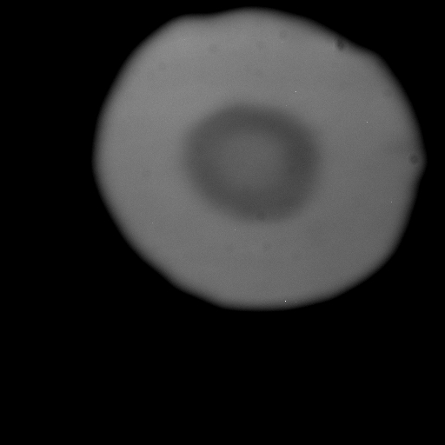
Notes:
9

Slide 11
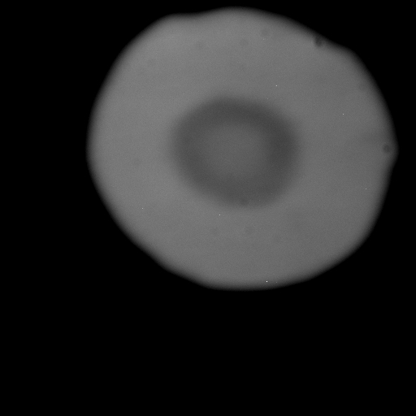
Notes:
10

Slide 12

Notes:
11

Slide 13

Notes:
12

Slide 14

Notes:
13

Slide 15

Notes:
14

Slide 16

Notes:
17

Slide 17

Notes:
18

Slide 18

Notes:
19

Slide 19

Notes:
20

Slide 20
Notes:
21

Slide 21

Notes:
22

Slide 22

Notes:
23

Slide 23

Notes:
24

Slide 24

Note response confined to laser target spot area.
Ledge and squidge.
[Quenched]
Notes:
25

